Slide 1
Table Tennis 進度報告 0412

Slide 2
Methods – Flowchart
After receiving a video, we extract the players' body keypoints and track the trajectory of the ball for 12 consecutive frames.
Then, combining these two information as a signal input, feed into
the 1D CNN model to classify whether it is a serving action.
The flowchart of our proposed method.

Slide 3
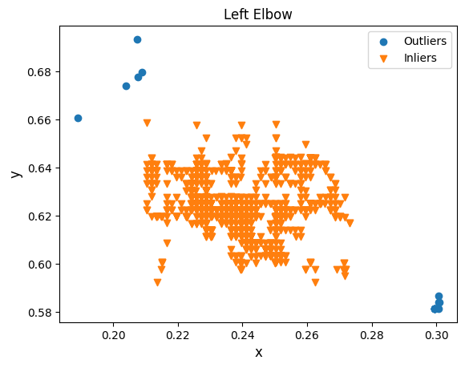
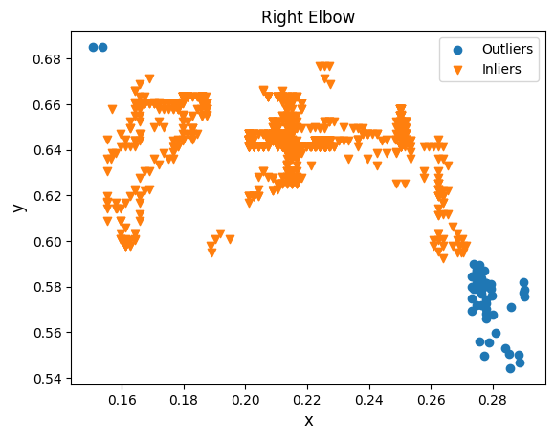
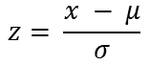
Methods – Data Preprocessing
We use Multiple Imputation by Chained Equations (MICE) to
handle missing values of pose estimation and ball trajectory.
Then, dealing with outlier using Z-score method.
$$z= \frac{x − μ}{σ}$$
Example of distribution of data while outlier is z > 2 .
It’s one of player’s elbows coordinates in a game.

Slide 4
Methods – Labeling
We take the 2D coordinates of the ball, shoulders, elbows and
wrists as a vector. And, using 30 consecutive vectors, which is
between the two sides of the highest peak of the ball height,
as a input unit of the 1D CNN model.
A unit of a model input.
It’s labeled as “left player serve”, “right player serve” or “not serve”.

Slide 5
Methods – 1D CNN
The model is currently for classify an action whether a ball serving action.
The model architecture of the ball serve detection, k – kernel size, s – stride.
Kulkarni, Kaustubh Milind, and Sucheth Shenoy. "Table tennis stroke recognition using two-dimensional human pose estimation." Proceedings of the IEEE/CVF Conference on Computer Vision and Pattern Recognition. 2021.

Slide 6
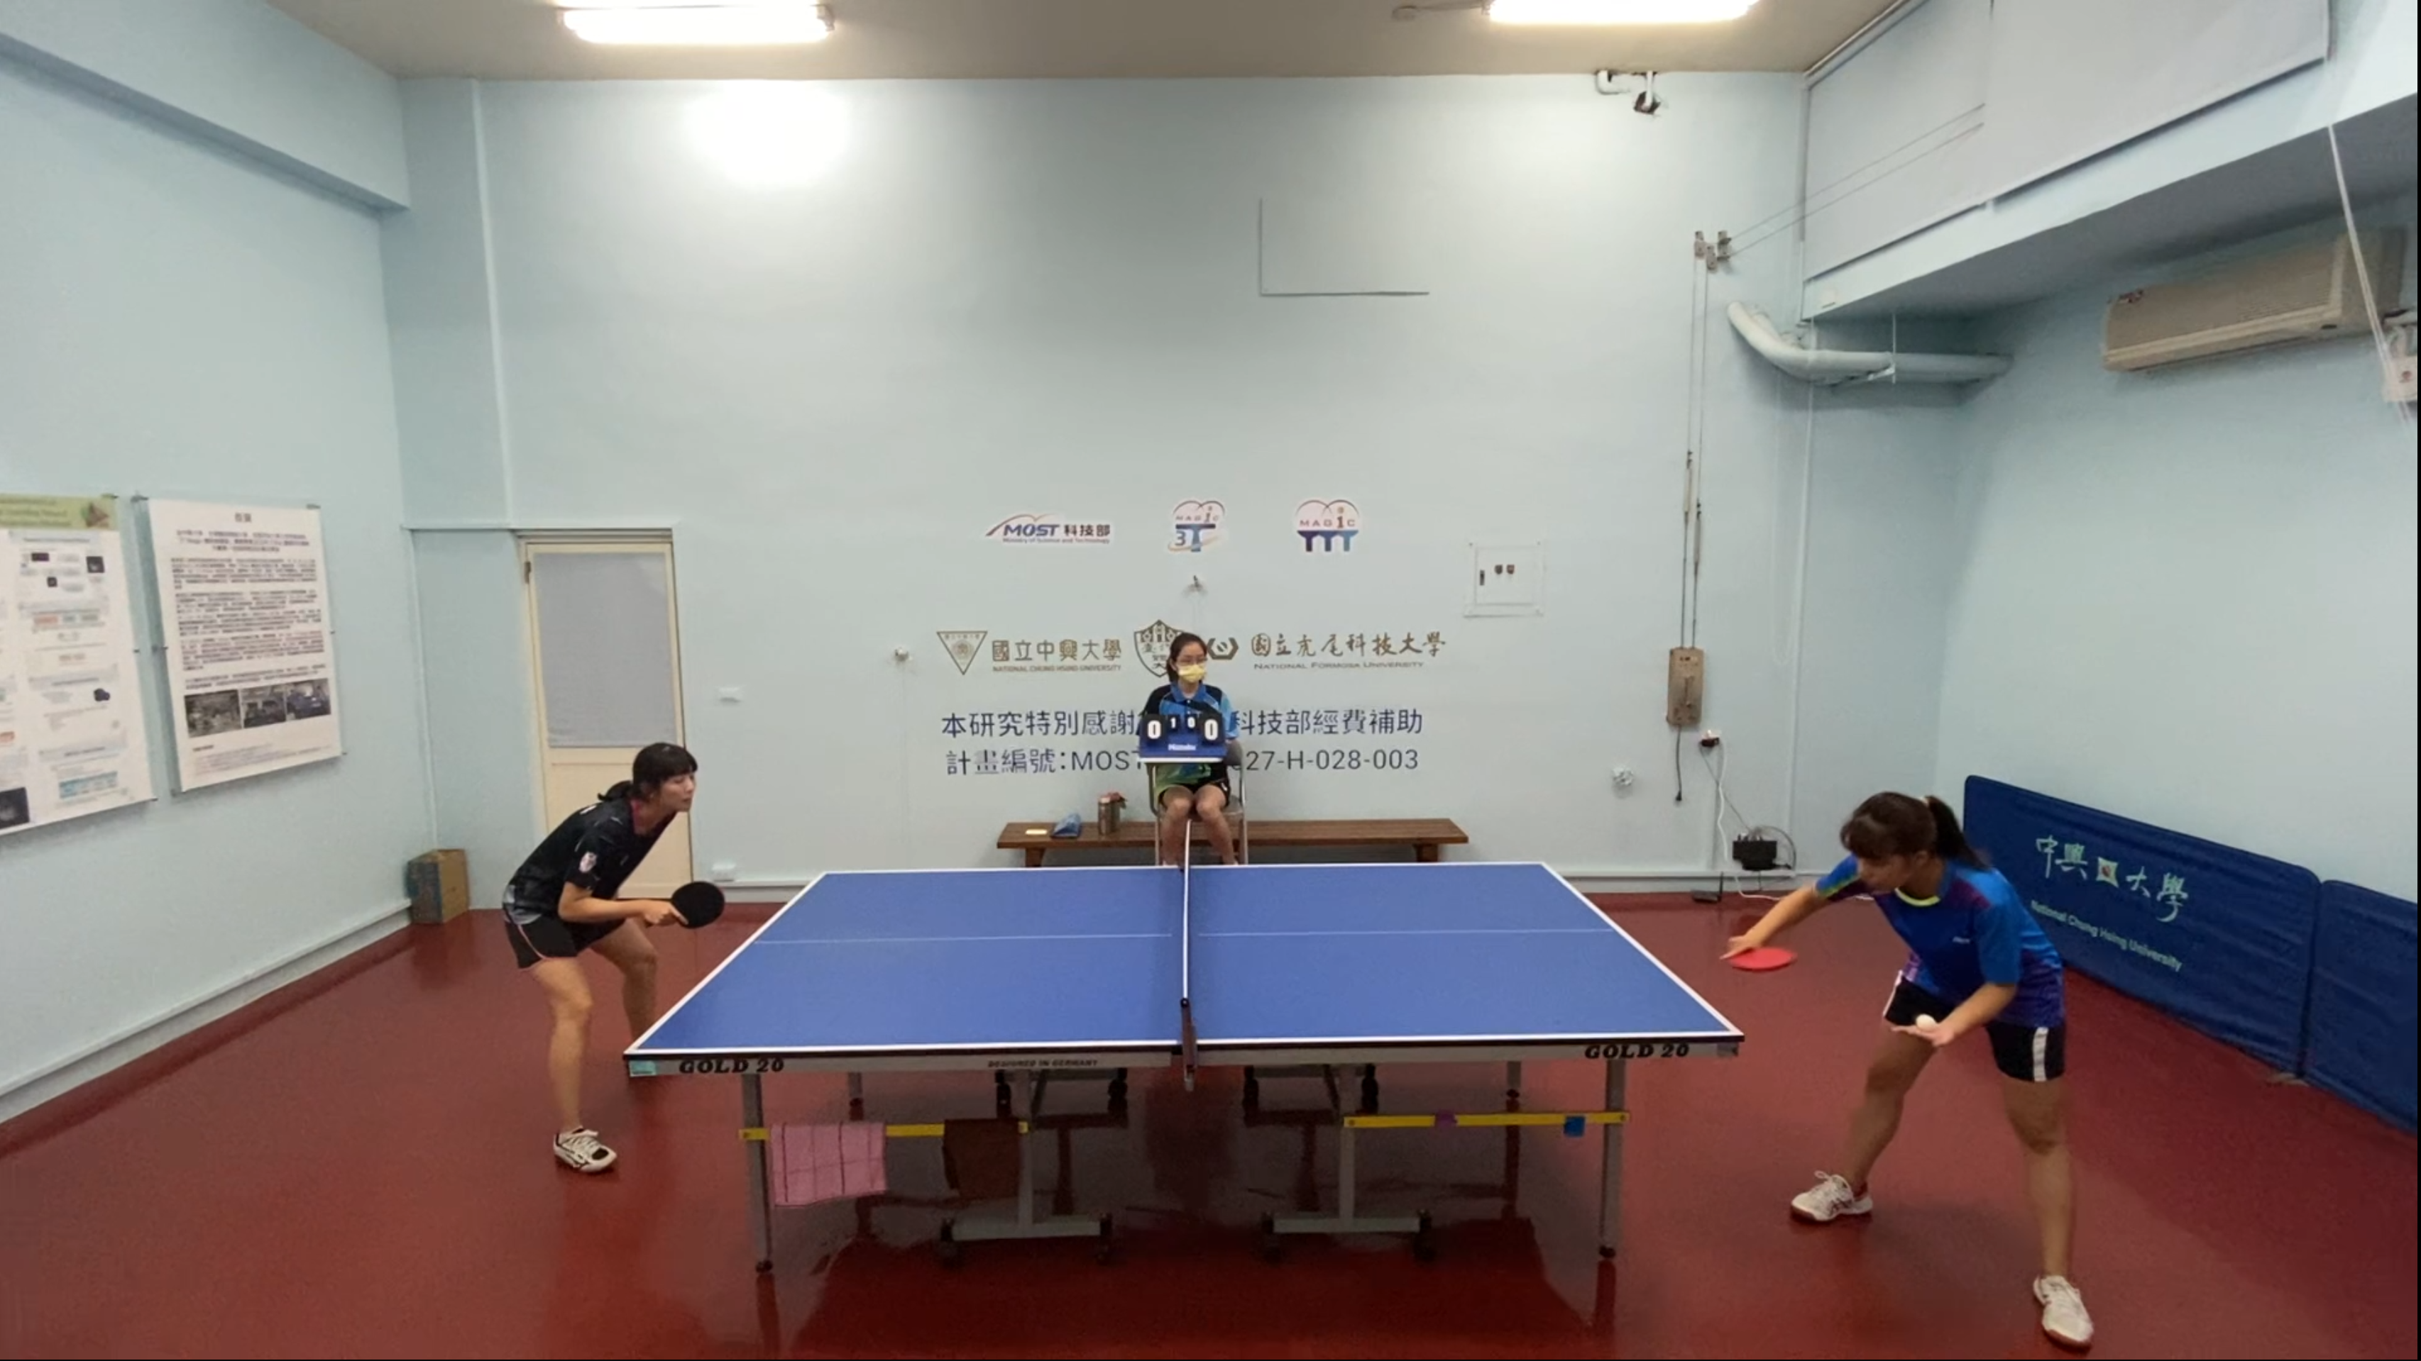
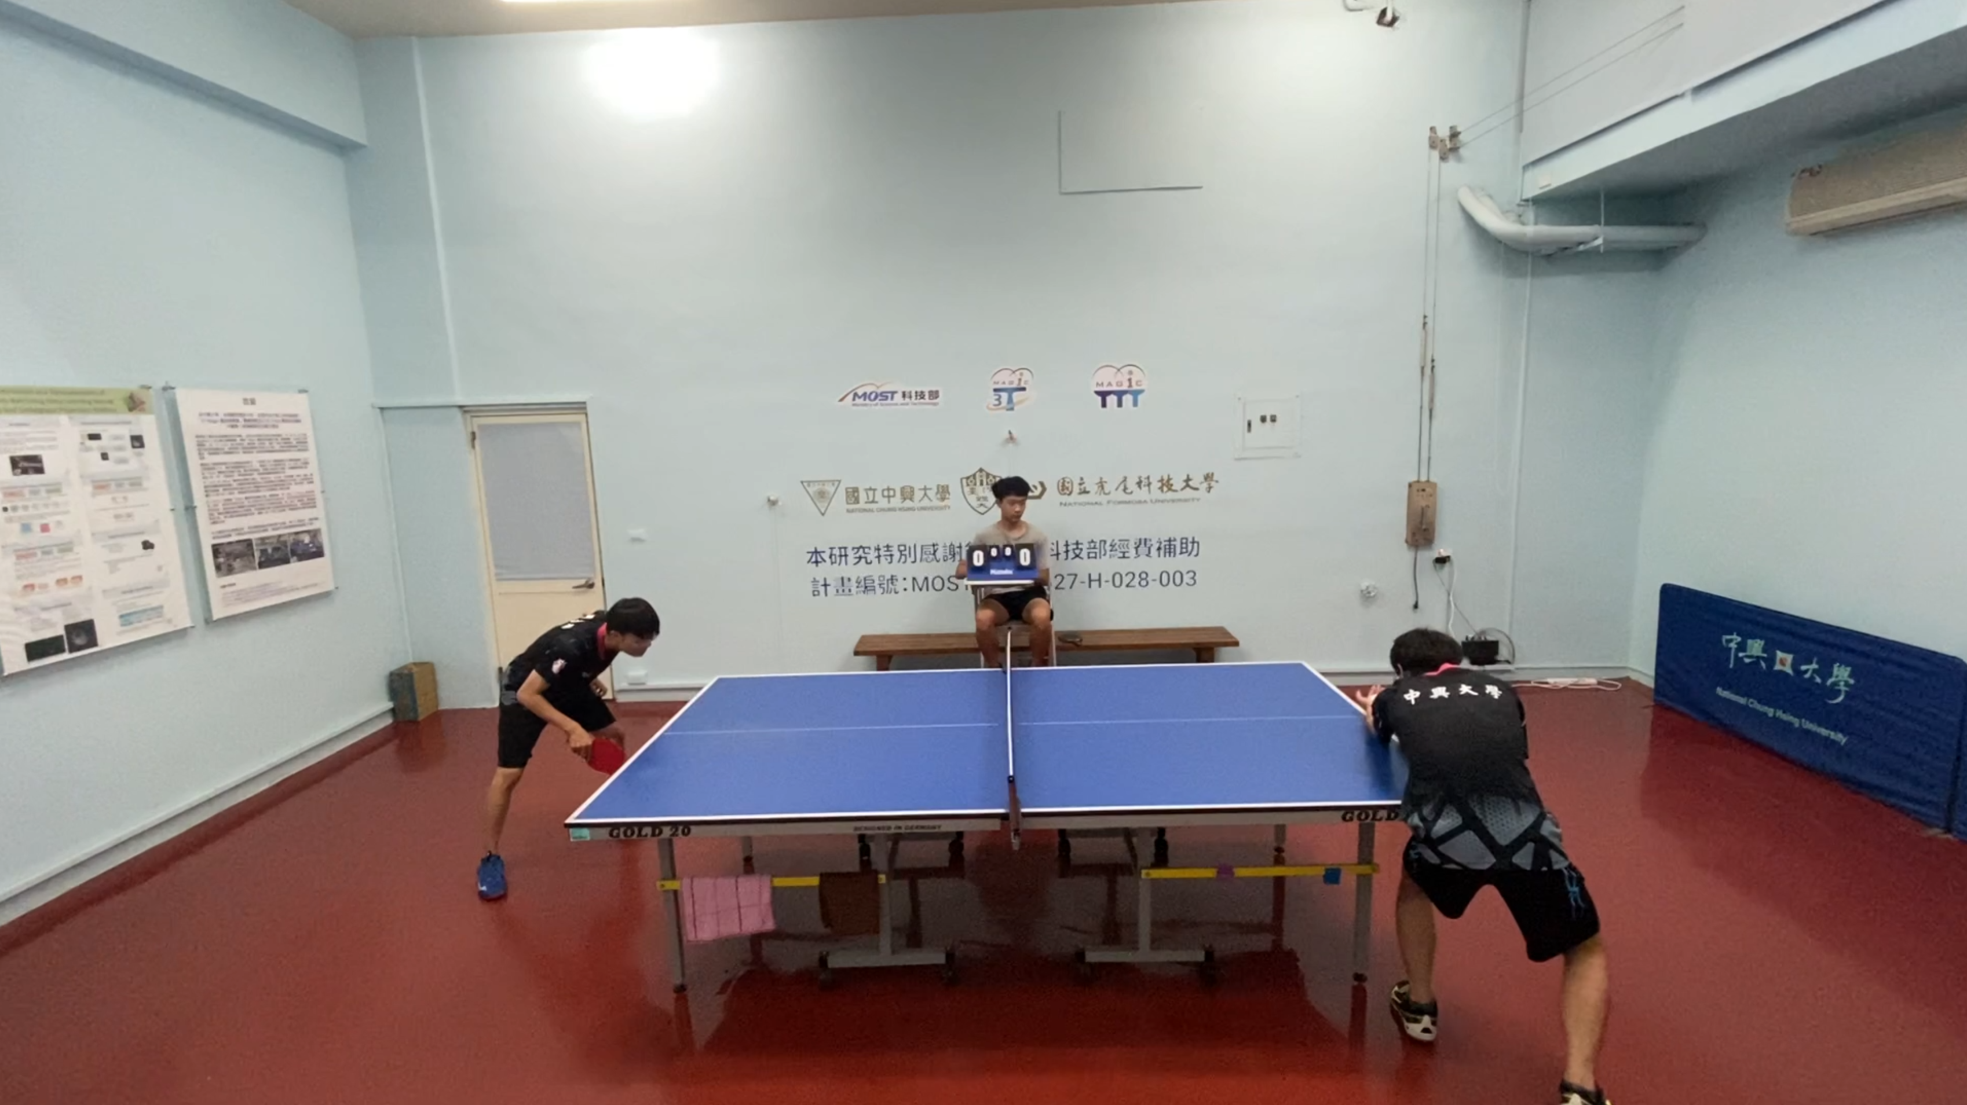
Experiments – Dataset
NCHU varsity table tennis game videos :
60 FPS, angle of one camera, two player and one referee
Training Dataset : 4 videos, total 55 times of ball serve.
Testing Dataset : 4 videos, total 80 times of ball serve.
The videos come from the varsity table tennis game.
Left side is the women’s group, and the right side is the men’s group.
All players are right-handed.
Notes:
F-1 : 13 (7+6)
F-2 : 16 (8+8)
F-4 : 6 (2+4)
M-1 : 7 (3+4)
M-4 : 13 (6+7)

Slide 7
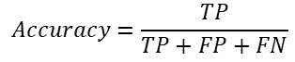
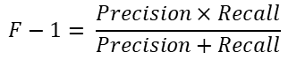
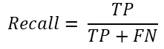
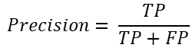
Experiments – Metrics
$$Accuracy=\frac{TP}{TP+FP+FN}$$
$$Precision= \frac{TP}{TP+FP}$$
$$Recall= \frac{TP}{TP+FN}$$
$$F−1= \frac{Precision×Recall}{Precision+Recall}$$
Serve Detection Results (4/19)
Dataset | video | GT_serve | TP | FP | FN | Accuracy | Precision | Recall | F-1
Testing | F-3 | 15 | 14 | 1 | 1 | 87.50% | 93.33% | 93.33% | 93.33%
 | M-2 | 19 | 17 | 4 | 2 | 73.91% | 80.95% | 89.47% | 85.00%
 | M-3 | 21 | 21 | 3 | 0 | 87.50% | 87.50% | 100.00% | 93.33%
 | Mix | 26 | 26 | 7 | 0 | 78.79% | 78.79% | 100.00% | 88.14%
 | Total | 81 | 78 | 15 | 3 | 81.25% | 83.87% | 96.30% | 89.66%
Serve Detection Results
Dataset | video | GT_serve | TP | FP | FN | Accuracy | Precision | Recall | F-1
Testing | F-3 | 15 | 14 | 0 | 1 | 93.33% | 100.00% | 93.33% | 96.55%
 | M-2 | 19 | 19 | 4 | 0 | 82.61% | 82.61% | 100.00% | 90.48%
 | M-3 | 21 | 21 | 1 | 0 | 95.45% | 95.45% | 100.00% | 97.67%
 | Total | 55 | 54 | 5 | 1 | 90.00% | 91.53% | 98.18% | 94.74%
Table of ball serve detection results.
F is women’s group, M is men’s group, Mix contains part of
women’s group game and part of men’s group game.

Slide 8
End

